Slide 1

Group Members
Saniya Rizwan: 2023-BCS-079
Kanwal Noor ul Ain: 2023-BCS-049
Hajra Iftikhar: 2023- BCS-035
Memona Bibi: 2023-BCS-055
Natasha Maryam: 2023-BCS-068
Hifsa Kanwal: 2023-BCS-039

Slide 2
Mathematical Problem-Solving Game

Slide 3

BACKGROUND
An intersection of education, gaming, and programming.
A console-based Mathematical Problem-Solving Game in C.
Designed to test and improve arithmetic skills.
Addressing the decline in fundamental math skills.
Transforming learning into a captivating and interactive experience.

Slide 4
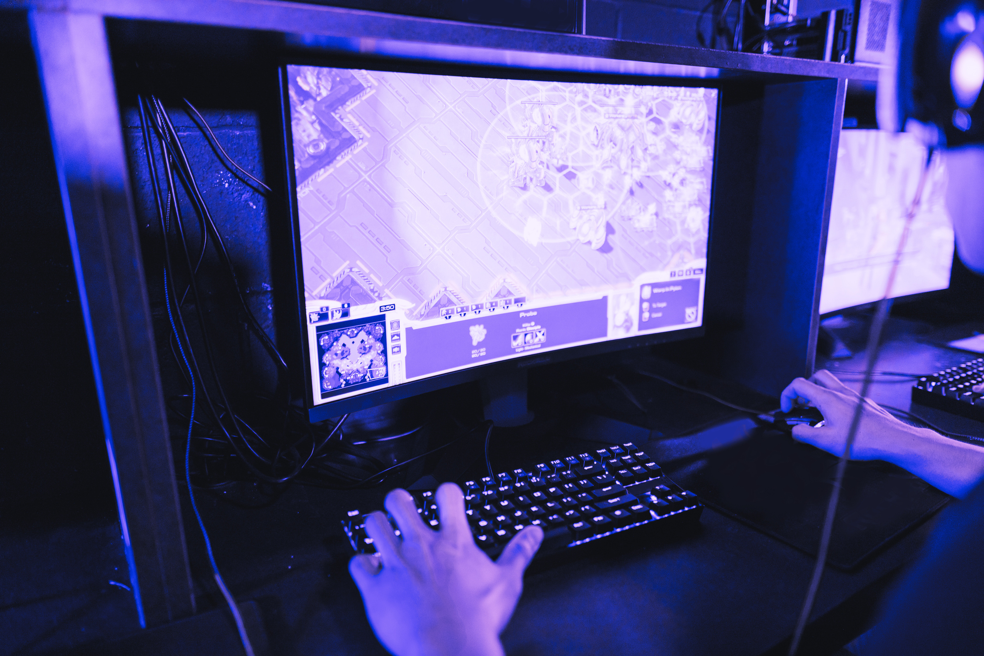
PROBLEM STATEMENT
Increased dependence on digital tools and calculators
Traditional teaching methods facing challenges in maintaining student engagement
Gap in the development of engagement tools for reinforcing basic skills.

Slide 5

INTRODUCTION
Redefines traditional approach to learning mathematics by transforming it into a captivating and interactive experience.
Combines elements of randomness, arithmetic challenges, and a scoring system
Engages users in solving mathematical problems.
Provides a continuous and adaptive learning experience.

Slide 6

METHODOLOGY
Incorporates random number generation for problem creation, arithmetic operations, and distinct levels of difficulty.
Utilize the ‘rand()’ function along with a seed based on the current time to produce random numbers with each playthrough
Difficulty level increases with every correct 5 set of questions and involves random operator

Slide 7

METHODOLOGY
Prompts the user to solve the generated mathematical question
Continues until the user decides to exit
The score is incremented for each correct answer
Incorrect answer prompts the display of correct solution

Slide 8

CONCLUSION
The game is a creative solution to address the declining mathematical proficiency
Leverages principles of gamification, and transforms learning into an interactive experience
Utilizes adaptive difficulty level to ensure users are consistently challenged.

Slide 9
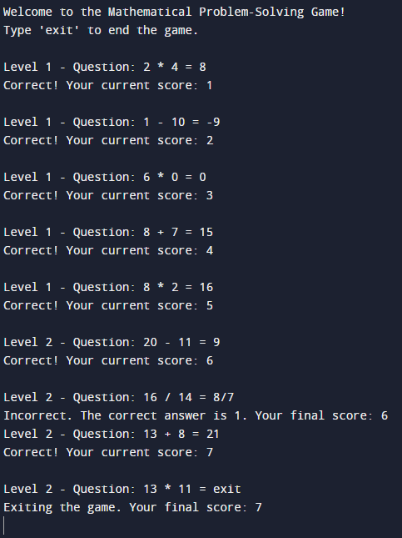

Slide 10

THANK
YOU

Slide 11
REFERENCES
Martins, V., de Almeida Souza Concilio, I. & de Paiva Guimarães, M., 2018. Problem based learning associated to the development of games for programming teaching. Computer Applications in Engineering Education, 26(5), pp. 1577-1589.
Seidametova, Z., 2020. Combining Programming and Mathematics through Computer Simulation Problems. ICTERI Workshops, Volume 2732, pp. 869-880.

